Slide 1
Connecting students to careers
Students explore how their strengths, interests and values connect to careers and how they can boost their careers readiness.
Subject: PSHE, Health and Wellbeing, CWRE, Learning for Life and Work
Ages: 11 to 16
Time: 1 x 55-minute lesson or 5 x 10-15-minute sessions

Slide 2
Learning objectives and outcomes
Learning objective
Students explore how their strengths, interests and values connect to careers and how they can boost their careers readiness.
Learning outcomes
Students will be able to:
define the career pathway factors of strengths, interests and values
understand how these factors affect career path decisions
demonstrate how to develop skills that are key for career readiness.
Key words
Strengths, skills, qualities, values, interests, developing, careers

Slide 3
Curriculum links
England
PSHE Association Programme of Study
KS3
L2. to review their strengths, interests, skills, qualities and values and how to develop them.
L3. to set realistic yet ambitious targets and goals.
L4. the skills and attributes that employers value.
L8. about routes into work, training and other vocational and academic opportunities, and progression routes.
L9. the benefits of setting ambitious goals and being open to opportunities in all aspects of life.
L11. different types and patterns of work, including employment, self-employment and voluntary work; that everyone has a different pathway through life, education and work.
L12. about different work roles and career pathways, including clarifying their own early aspirations.
KS4
L1. to evaluate and further develop their study and employability skills.
L2. to evaluate their own personal strengths and areas for development and use this to inform goal setting.
L3. how their strengths, interests, skills and qualities are changing and how these relate to future career choices and employability.
L4. about the range of opportunities available to them for career progression, including in education, training and employment.
Gatsby careers benchmarks
2. Learning from career and labour market information – access to good quality information.
3. Addressing the needs of each pupil - including challenging stereotypes and raising aspirations.
4. Linking curriculum learning to careers - how the different STEM subjects help people to gain entry to, and be more effective workers within, a wide range of careers.

Slide 4
Curriculum links
Scotland
Health and wellbeing Planning for choices and changes
Third I am developing the skills and attributes which I will need for learning, life and work. I am gaining understanding of the relevance of my current learning to future opportunities. This is helping me to make informed choices about my life and learning. HWB 3-19a
Fourth Based on my interests, skills, strengths and preferences, I am supported to make suitable, realistic and informed choices, set manageable goals and plan for my further transitions. HWB 4-19a
Third / Fourth I am investigating different careers/occupations, ways of working, and learning and training paths. I am gaining experience that helps me recognise the relevance of my learning, skills and interests to my future life. HWB 3-20a / HWB 4-20a
Careers Education Standard
P7 I can discuss the relevance of skills to the wider world and make connections between skills and the world of work.
I can explain to others my ambitions/what I would like to do and look for ways to achieve them/that.
I can recognise the skills I have and need for work.
I can apply my skills to get more information about jobs/careers.
I can use online tools available to me.
S1-S3 I can demonstrate and apply the skills I have learnt across the curriculum in relation to the world of work.
I can identify my interests, strengths and skills and use them to make informed choices.

Slide 5
Curriculum links
Wales
Careers and Work-Related Experiences (CWRE)
Exploring self and society
Widening horizons
Overcoming barriers
Exploring opportunities
Developing adaptability and resilience
Northern Ireland
Learning for Life and Work
KS3
Employability - career management.
Assess personal skills and achievements to date; identify areas of interest and set targets for self improvement.
Explore the changing concept of career.
Engage in the personal career planning process to investigate and reach decisions about post-14 options.
Investigate a variety of both familiar and unfamiliar jobs.
KS4
Employability
Develop a personal career plan based on relevant information and guidance.

Slide 6
Lesson overview
This lesson can be delivered as one 55-minute workshop or as five 10 to 15-minute sessions.
Slide | Overview | Timing | Resources
Introduction | Understand what impacts career choices and begin thinking about which characteristics align with various roles. | 10 minutes
Activity 1 | Choose a character (a celebrity, historical figure, from a book or TV show) and identify their skills and qualities. | 10 minutes | Career Clinic worksheet (1 per student)
Activity 2 | Develop the character by identifying their interests. | 10 minutes
Activity 3 | Align the character's values and beliefs with their life choices and career options. | 10 minutes
Activity 4 | Finalise the character profiles and play Top Trumps. | 15 minutes | Blank Top Trump card (1 per student)

Slide 7
Introduction:
Choosing a career path
Notes:
Introduction – 10 minutes

Slide 8
How do you choose a career path?
Today, many people do different jobs throughout their careers. But how do they decide what they want to do?
Strengths (skills and qualities)
Interests
What factors affect your career path?
These all may change throughout your life!
Values
Notes:
Introduction – 5 minutes
Ask students to consider the question on the slide, considering what affects their hopes for future careers.
Click to reveal the diagram and additional text box after a class discussion about what factors affect decisions.

Slide 9
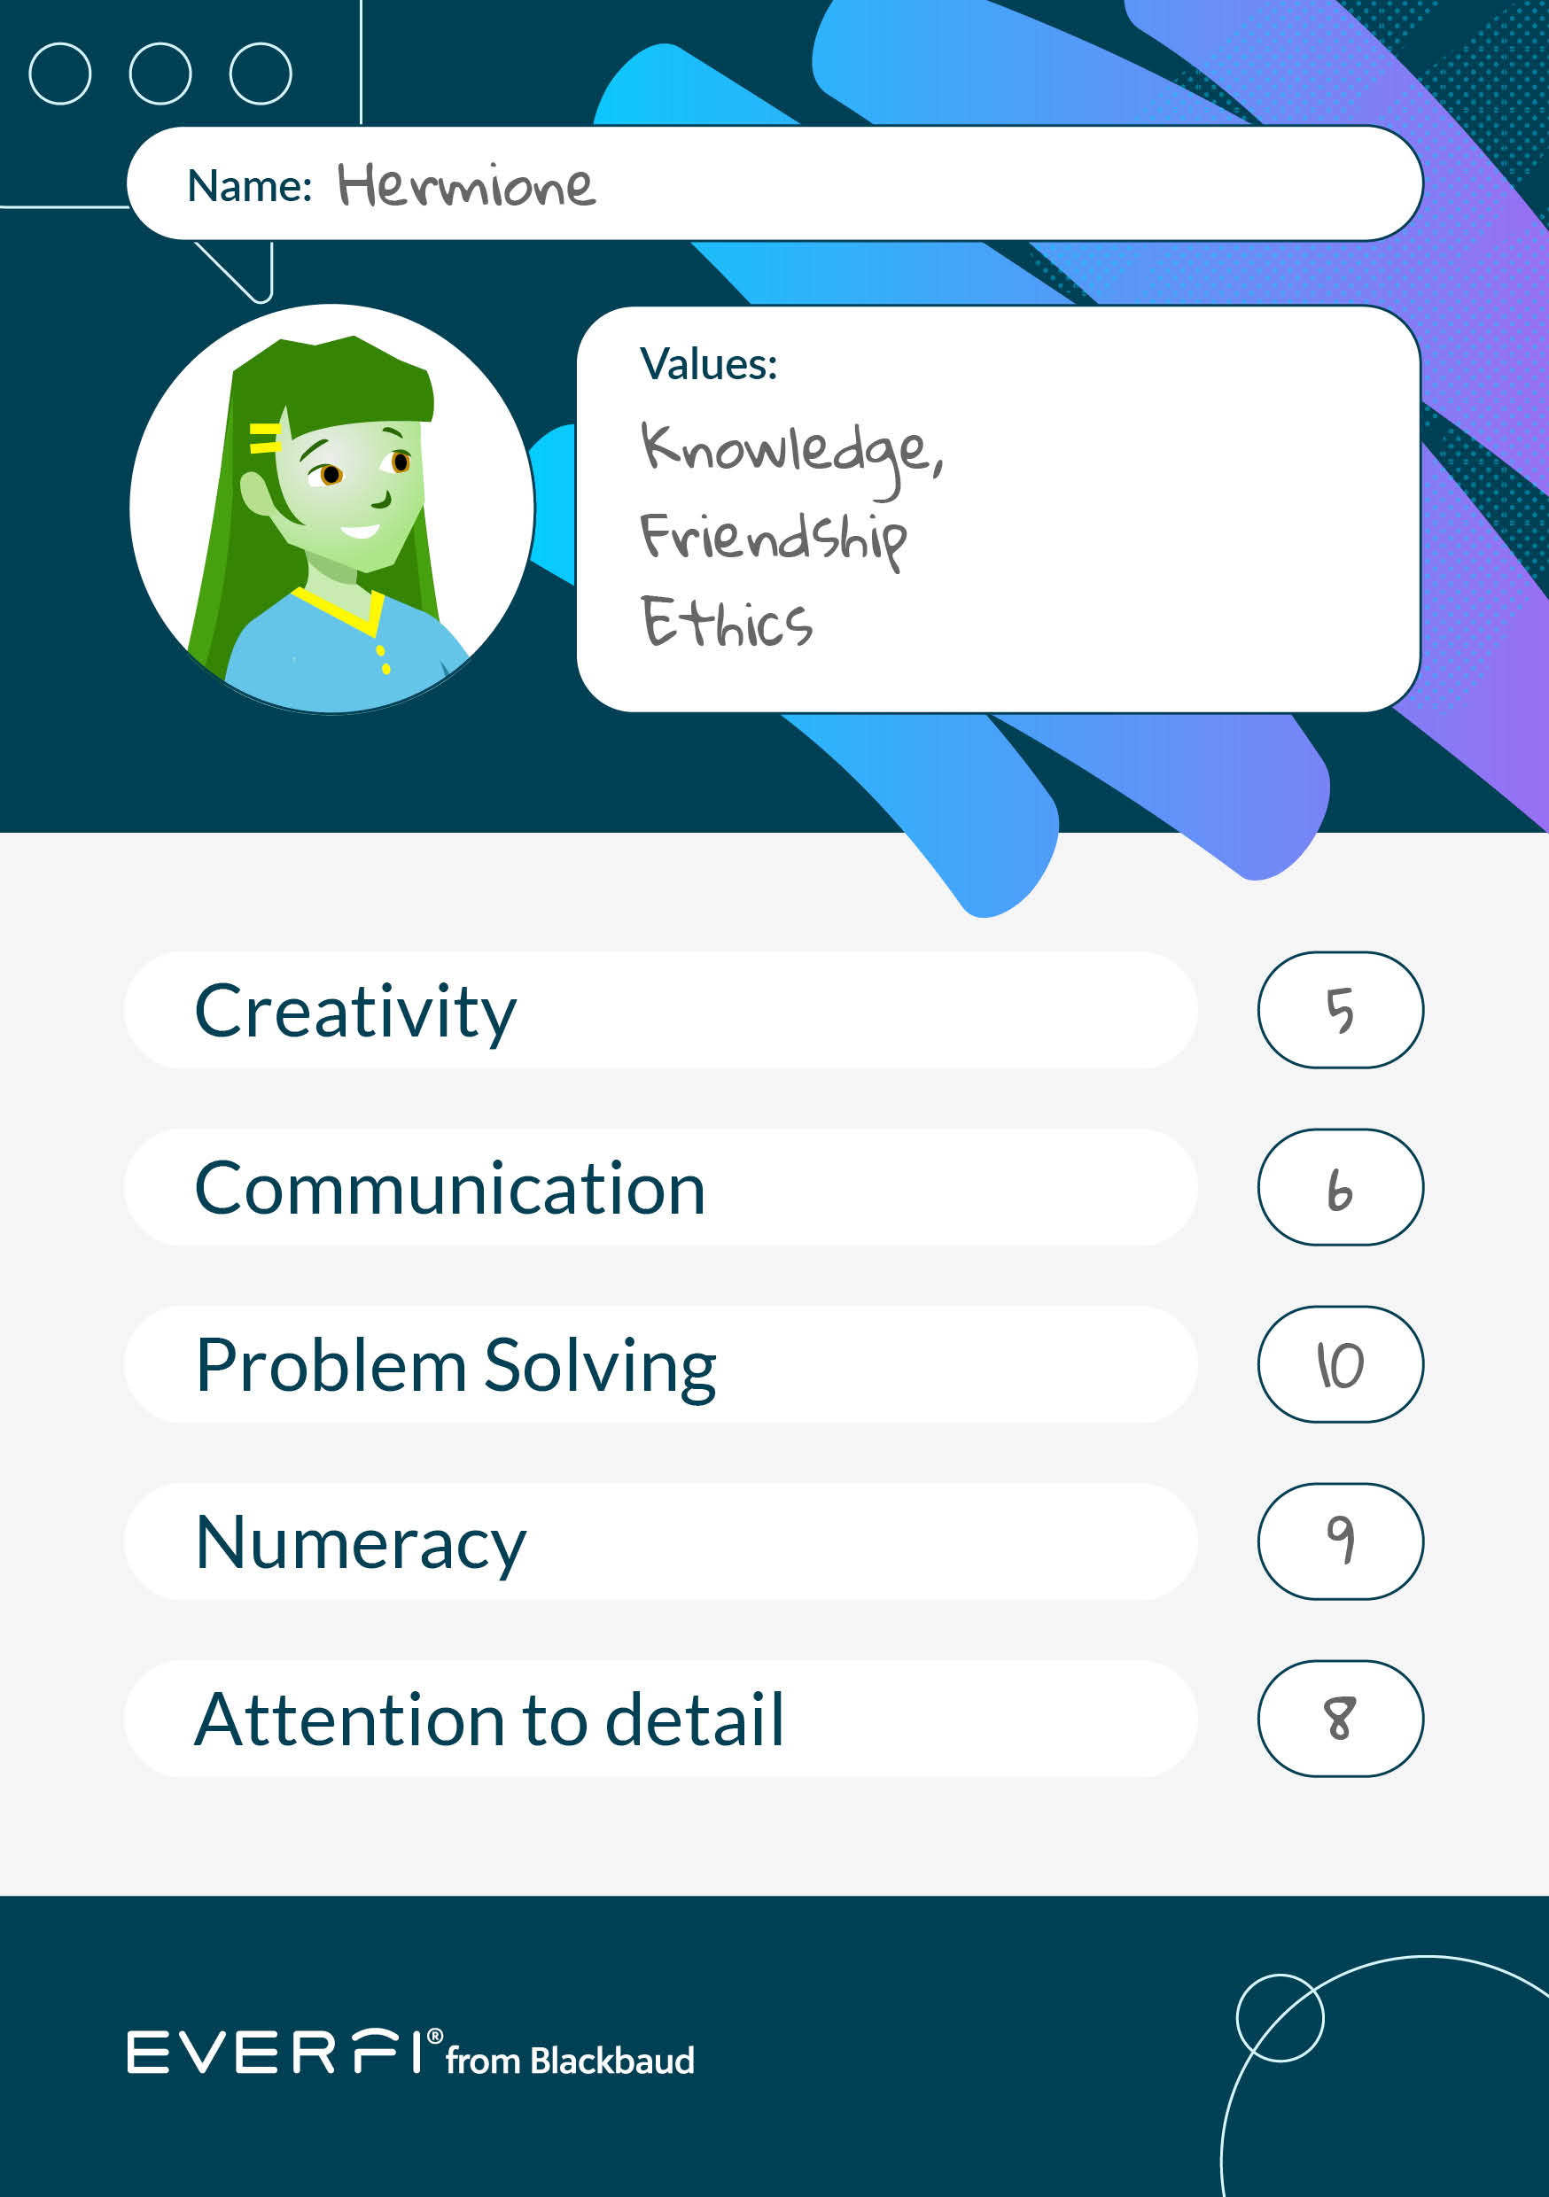
Careers clinic!
We are going to:
think about what strengths, interests and values are
choose a character from a book, TV show or film or a historical figure or celebrity and identify their strengths, interests and values
become careers advisors and match these characters to careers.
Notes:
Introduction – 5 minutes
Introduce the Careers clinic concept to students.
Explain that students are going to become careers advisors for a chosen character. They should choose someone that they know well. The character might be leaving education and looking for their first job, or they might To do that, they need to consider:
What strengths, interests and values are
The strengths, interests and values of others
Match characteristics to appropriate job roles
Consider how we can develop skills and qualities

Slide 10
Career clinic worksheet
Worksheet
Choose a character from a book, TV show or film. Identify factors that might affect their career path decisions.
Name:
Current job:
Strengths (skills and qualities)
Top three interests (underline the most important)
1. 2. 3.
Top three values (underline the most important)
1. 2. 3.
Strength to develop:
How:

Slide 11
Part A:
Exploring factors that affect career decisions

Slide 12
Activity 1:
What are your strengths?
Notes:
Part A, Activity 1 – 10 minutes

Slide 13
Identifying strengths
Your strengths are skills and qualities that help you in your career and your life.
Choose a character from a book, TV show or film (or a historical figure or celebrity).
Write down what you think their strengths are.
Notes:
Part A – 10 minutes
Before handing out the worksheet, ask students to jot down all of the strengths they can think of.
Ask students to think of a character, celebrity or historical figure that they know a lot about.
Once students have had chance to think of some of their own examples of strengths, hand out the career clinic worksheet and direct them to fill in the sections highlighted in blue.
To support this activity, show the examples on slide 14.

Slide 14
Examples of strengths
Communication
Attention to detail
Logical thinking
Analysing information
Computer literacy
Good listener
Creativity
Planning work
Leadership
Time management
Resilience
People skills
Conscientious
Organisation
Problem solving
Notes:
Part A – 10 minutes
Show this slide when students are filling in the first sections of the worksheet. Encourage them to use the examples on the slide to fill in their character skills and abilities.
If they finish early, see if they can share their ideas with another student and explain their choices.

Slide 15
Activity 2:
Why are interests important?
Notes:
Part A, Activity 2 – 10 minutes

Slide 16
Why are interests important?
Identifying what you are interested in can help steer you to a great career choice.
General interest | Career interest | How about becoming...
Technical Lego | Designing and building
Volunteering at local community centre | Helping people
Wildlife and the natural world | Sustainability
Playing videos games with friends | Technology and coding
An aerospace engineer
A midwife
An environmental consultant
A video game developer
Doing something you enjoy is motivating and can lead to job satisfaction and success.
Notes:
Part A, Activity 2 – 5 minutes
Ask students to suggest possible careers that link to the interests on the slide. This will get the students to start considering the role of a careers advisor.
Click to reveal the 'How about becoming a...' answers one by one.
Remind students that interests are just one element to consider when suggesting possible career paths.

Slide 17
Identifying interests
What are your character’s top three interests?
Things to consider:
Does your character like to do things alone or with others?
Does your character like to explore new interests?
What impacts their top three interests? (time, money, other commitments)
Notes:
Part A, Activity 2 – 5 minutes
Prompt students to think back to the character they chose in Activity 1.
Ask them to fill in the section in blue, identifying their character’s top three interests as well as which one is the most important.
Remind students that a career doesn’t have to align with interests and will often not meet all three but finding a job which fits at least one interest will make the work more enjoyable.
Students have now explored how strengths and interests can affect decisions about career choice, but there's one more element to look at before we are ready to become careers advisors.

Slide 18
Activity 3:
Aligning values and choices
Notes:
Part A, Activity 3 – 10 minutes

Slide 19
What are values?
Values are core, fundamental beliefs that help you decide what is important and what is not.
Can you think of some examples?
Notes:
Part A, Activity 3
Introduce this section by reading out the question ‘What are values?’.

Slide 20
Identifying values
and priorities
What would be your character's top 3 values?
Use the list on the previous slide for inspiration.
Think about...
How they would choose to spend a totally free day
What qualities they bring to every situation
What they would like to be known for
Notes:
Part A, Activity 3 – 5 minutes
Prompt students to think back to the character they chose in Activity 1.
Ask them to fill in the section in blue, identifying their character’s top three values as well as which one is the most important.
To support students, show the list of values on slide 21. Note that this is NOT an exhaustive list and students may think of more.

Slide 21
What are values?
These are just some examples, not an exhaustive list.
Family
Originality
Happiness
Respect
Tradition
Career progression ​
Friendship and connection
Empathy ​
Appearance and style​
Creativity
Wealth
Diversity
Freedom and independence
Ethics
Health and wellbeing​
Excitement
Sustainability
Efficiency
Community​
Consistency
Charity
Helping others
Fame
Routine
Self-motivation
Equality and fairness ​
Pursuit of knowledge
Fitness
Security / Stability
Self-respect​
Notes:
Part A, Activity 3
Highlight to students that the lines are blurred between strengths, interests and values. For example, helping others is a value but can also be an interest.

Slide 22
Aligning our values and our choices
Think, Pair, Share!
How might you feel if your choices and actions align with your values and priorities?
You might feel content, energised, that life has meaning and have higher self-esteem.
What about if they don't?
You might feel frustrated, drained and have lower self-esteem.
Why might your choices not align with your values?
You might take the easier option, or feel pressure from others.
align (verb)
Line up; be the same or similar to; agree with or support.
Notes:
Part A, Activity 3 – 5 minutes
Students will Think, Pair, Share answers to the questions on the slide.
This could also be run as a whole class activity.
Click to reveal each suggested answer after the students have had time to consider their own answers.

Slide 23
Part B:
Career clinic!

Slide 24
Activity 4:
Skill development and Top Trumps
Notes:
Part B, Activity 4 – 15 minutes

Slide 25
How can your characters get career ready?
What could they do to make their strengths even stronger?
Do they have any weaknesses that might stand in their way? What could they do to help?
Example: Vivi wants to be a journalist.
She is already good at writing but she needs to practise more, so she joins the school newspaper team and enters a youth writing competition.
She is not very confident – so she volunteers at her local to help get her used to talking to people.
Notes:
Part B, Activity 4 – 5 minutes
Ask students to identify some skills or qualities their characters could develop, adding these to their worksheets.
Once identified, encourage students to consider ways in which these skills could be developed (using Vivi as an example).

Slide 26
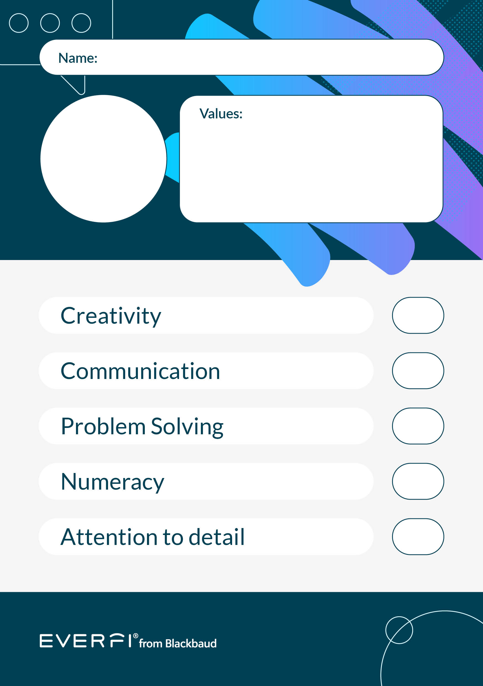
Welcome to career top trumps!
It’s time to find the perfect career for your character.
Complete a top trumps card for them!
Note down their values in the space at the top.
Then score them out of 10 on five key employability skills.
Notes:
Part B, Activity 4 – 10 minutes
Introduce the top trumps activity, reminding students that every character has individual strengths and qualities. No character is better or worse than another. Each character will have a different skill set depending on their interests, technical skills, career path and natural abilities.

Slide 27
Welcome to career top trumps!
1
2
Look at your top trumps cards
Match each character to one of the careers cards
3
Explain to the group why you thought they might be suited to the job and why they would be good at it
Notes:
Part B, Activity 4 – 5 minutes
Divide class into small groups.
Give each group a set of top trump cards and careers cards.
Students get one top trump card each. Follow the instructions on the slide.

Slide 28
Make your own
top trump card
Notes:
Part B, Activity 4 – 10 minutes
Now students can make their own top trump card for the character they created earlier. They may have already identified the characteristics on the card as a strength in which case they give them a high number. If not, they can consider these characteristics now.
Remind students that not every quality can be a 10 and it is normal for people to be better at some things and weaker at others. For example, someone with strong creative qualities may not be very analytical.
Students can now repeat the activity from slide 27, using their own cards.

Slide 29
Make your own top trump card

Slide 30
Find out more
EVERFI has a wide range of courses building knowledge in growth career areas and/or developing employability skills:
Data Science
Data Science Foundations
Sustainability
Sustainability Foundations
Plants, Animals, and Our World
STEM careers
Endeavour
Economics and personal finance
Aspire: Preparing for your financial future
Thrive: You and your money
Mental Health
Understanding Mental Wellbeing
Notes:
These are links to other careers resources on the EVERFI platform that teachers might be interested in doing.

